Slide 1
AI-Based Diabetes Prediction System
innovative techniques and deep learning architectures to improve the prediction system's accuracy and robustness.
Submitted by : Venkappagari Shyam Kumar
Dept: Ai & Ds
Roll No :723921243055

Slide 2
To Improve The Accuracy And Robustness Of An Ai-based Diabetes Prediction System, We Can Leverage A Combination Of Ensemble Methods And Deep Learning Architectures. Here's How You Can Integrate These Techniques Into The System:
Ensemble Methods:
Ensemble methods combine multiple machine learning models to make predictions, often resulting in improved accuracy and robustness. For a diabetes prediction system, we can use ensemble methods as follows:
Random Forest for Feature Selection and Prediction:
Utilize a Random Forest ensemble to select the most important features from your dataset, which can help improve the interpretability and accuracy of the model.

Slide 3
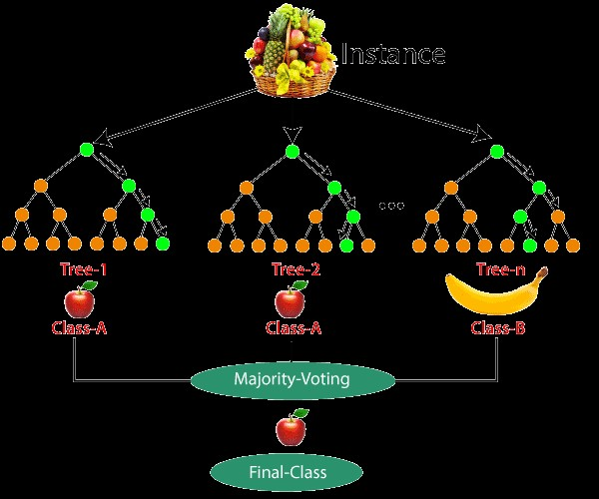
2.Gradient Boosting for Robustness:
Implement Gradient Boosting algorithms like XGBoost or LightGBM to build an ensemble of trees. These algorithms can adapt to the complexity of the data and reduce overfitting, thereby enhancing the model's robustness.

Slide 4
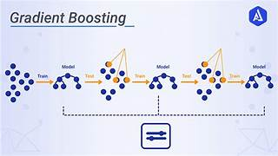
3.Voting Classifier:
Create a voting classifier that combines predictions from multiple base models, such as logistic regression, decision trees, and support vector machines. This ensemble can improve accuracy by aggregating diverse model outputs.

Slide 5
Deep Learning Architectures:
Deep learning architectures are well-suited for handling complex, high-dimensional data. For a diabetes prediction system, consider the following deep learning techniques:
1.Multi-Layer Perceptrons (MLPs):
Use deep feedforward neural networks (MLPs) to process structured data, such as patient demographics, medical history, and lab results. You can experiment with different architectures and layer sizes to find the best-performing model.
2.Convolutional Neural Networks (CNNs):
If your dataset includes medical images or scans relevant to diabetes, such as retinal images, CNNs can be employed to extract meaningful features and improve predictive accuracy.
3.Recurrent Neural Networks (RNNs) with Long Short-Term Memory (LSTM):
For temporal data, like blood glucose measurements over time, implement RNNs with LSTM cells. These architectures can capture sequential dependencies and are essential for time-series data analysis.

Slide 6
4.Ensemble Methods:
Ensemble techniques like Random Forest, Gradient Boosting, or Voting classifiers can be used to combine the predictions from multiple machine learning models, improving accuracy.
5.Explainability and Interpretability:
Techniques for model explainability, such as SHAP or LIME, are integrated to make model predictions interpretable to healthcare providers and patients.
6.Longitudinal Data Analysis:
If applicable, use recurrent neural networks (RNNs) or time series models to analyze how patient data evolves over time, capturing dynamic patterns.
7.Mobile Application (User Interface):
A user-friendly mobile app allows individuals to input their health data and receive diabetes risk predictions. The app may also provide personalized recommendations for lifestyle changes and monitoring.
8.Privacy and Security:

Slide 7
Robust privacy and security measures are implemented to protect sensitive health data. Compliance with data protection regulations, such as HIPAA or GDPR, is ensured.
9.Feedback and Continuous Improvement:
A feedback loop is established to refine the model's predictions over time based on real-world outcomes and user feedback.
10.Collaboration with Healthcare Providers:
The system is integrated into clinical practice, facilitating communication between AI predictions and healthcare providers for better patient care.
11.Community Outreach:
Educational campaigns raise awareness about diabetes risk factors and prevention strategies. Resources and support are provided for individuals at risk.
12.Scalability and Accessibility:
The system is designed to accommodate a large user base and is made accessible to underserved populations, potentially through partnerships with community health clinics.

Slide 8
13.Research and Validation:
Continuous validation of AI model predictions is conducted through clinical studies and real-world data. Research findings are published to demonstrate system effectiveness.
This architecture provides a comprehensive framework for an AI-based diabetes prediction system, which incorporates data collection, preprocessing, modeling, user interface, privacy, and collaboration with healthcare providers. The system is designed to continuously improve and adapt to changing health conditions and research findings.

